Slide 1
Operation Analytics And Investigating Metric Spike
SUBMITTED BY :
ANISH KATOCH

Slide 2
PROJECT DESCRIPTION
The objective of this project is to analyze the data provided by the company and use it to provide insights that will answer various questions from different departments. The insights derived will be leveraged by teams such as operations, support, and marketing to forecast the company's overall growth or decline. The expected outcome is to improve automation, enhance collaboration and understanding between cross-functional teams, and establish effective workflows. In the first case study, the data to be analyzed is contained in the job_data table, while in the second case study, the data is spread across the users, events, and email_events tables.

Slide 3
APPROACH
The initial step of the project is to set up a database using the dataset file provided by the company. The subsequent task is to perform an analysis on the dataset to extract useful insights that can help address key questions, such as why there has been a decline in daily engagement. To stay on top of the situation, it is crucial to investigate any unusual spikes in metrics that occur on a daily basis. These types of inquiries must be addressed regularly to ensure the company's performance stays on track.

Slide 4
TECK STACK
I have used MySQL Workbench and the version is 8.0.32.
MySQL is one of the most popular database management system where we can collect, stored and organized the data in structured way. It is user friendly and good for application that totally rely on multi-row transaction.
It provides flexibility and scalability, data protection, open source and compatible, fast and reliable and for analysis it is one of the best software.

Slide 5
INSIGHTS
The field of operational analytics addresses the challenge of harmonizing real-time data from various sources. Through the use of analytics, it is possible to collate data from multiple sources, organize it into a cohesive, actionable solution, and develop analytical models in real-time. This approach provides a comprehensive view of operations and profiles that can help ensure that systems are being used efficiently. When employed effectively, operational analytics can have a significant positive impact on society and the world as a whole, enhancing the overall efficiency of specific domains.
In case study 2 is the large size of the dataset. As the dataset is very large, importing it into SQL Workbench is a slow process. To overcome this challenge, the approach used is to employ LOAD DATA statements to expedite the data loading process.

Slide 6
CASE STUDY 1 JOB DATA

Slide 7
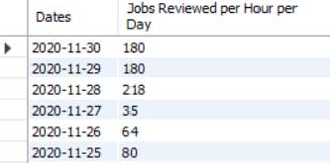
Number of Jobs reviewed
Select ds as dates, round((count(job_id)/sum(time_spent))*3600) as "jobs reviewed per hour per day“ from job_data where ds between '2020-11-01' and '2020-11-30' group by ds;

Slide 8

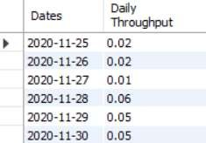
Throughput
Select round(count(event)/sum(time_spent), 2) as "weekly throughput" from job_data;
Select ds as dates, round(count(event)/sum(time_spent), 2) as "daily throughput" from job_data group by ds order by ds;

Slide 9
It is normal for metrics to fluctuate on a weekly and daily basis. If necessary, it is possible to obtain daily or even minute-by-minute numbers for these metrics. To determine whether metrics are trending upwards or downwards on a daily basis, rolling metrics are an excellent tool. These metrics provide an overview of how the metrics are evolving over time, making it easier to assess their overall trend.

Slide 10
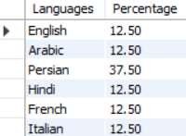
Percentage share of each language
Select language as languages, round(100 * count(*)/total, 2) as percentage from job_data cross join (select count(*) as total from job_data) sub group by language;

Slide 11

Duplicate rows
Select actor_id, count(*) as duplicates from job_data group by actor_id having count(*) > 1;

Slide 12
CASE STUDY 2 INVESTIGATING Metric Spike

Slide 13
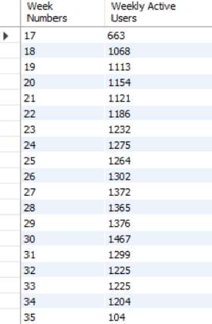
User Engagement
select extract(week from occurred_at) as "week numbers", count(distinct user_id) as "weekly active users“ from events where event_type = 'engagement' group by 1;

Slide 14
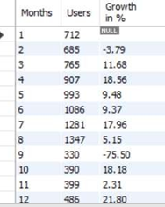
User Growth
select months, users, round(((users/lag(users, 1) over (order by months) -1)*100), 2) as "growth in %" from (select extract(month from created_at) as months, count(activated_at) as users from users where activated_at not in("") group by 1order by 1) sub;

Slide 15
Weekly Retention
select first as "week numbers",
sum(case when week_number = 0 then 1 else 0 end) as "week 0",
sum(case when week_number = 1 then 1 else 0 end) as "week 1",
sum(case when week_number = 2 then 1 else 0 end) as "week 2",
sum(case when week_number = 3 then 1 else 0 end) as "week 3",
sum(case when week_number = 4 then 1 else 0 end) as "week 4",
sum(case when week_number = 5 then 1 else 0 end) as "week 5",
sum(case when week_number = 6 then 1 else 0 end) as "week 6",
sum(case when week_number = 7 then 1 else 0 end) as "week 7",
sum(case when week_number = 9 then 1 else 0 end) as "week 9",
sum(case when week_number = 10 then 1 else 0 end) as "week 10",
sum(case when week_number = 11 then 1 else 0 end) as "week 11",
sum(case when week_number = 12 then 1 else 0 end) as "week 12",
sum(case when week_number = 13 then 1 else 0 end) as "week 13",

Slide 16
sum(case when week_number = 14 then 1 else 0 end) as "week 14",
sum(case when week_number = 15 then 1 else 0 end) as "week 15",
sum(case when week_number = 16 then 1 else 0 end) as "week 16",
sum(case when week_number = 17 then 1 else 0 end) as "week 17",
sum(case when week_number = 18 then 1 else 0 end) as "week 18",
from (select m.user_id, m.login_week, n.first, m.login_week - first as week_number from (select user_id, extract(week from occurred_at) as login_week from events group by 1, 2) m, (select user_id, min(extract(week from occurred_at)) as first from events group by 1) nwhere m.user_id = n.user_id) sub group by first order by first;

Slide 17
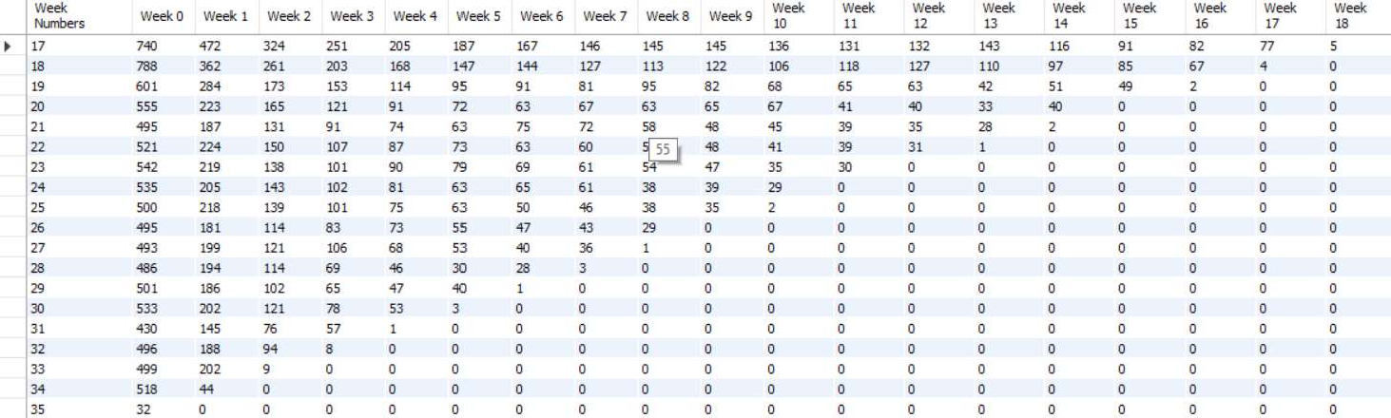

Slide 18
Weekly Engagement
Select extract(week from occurred_at) as "week numbers",
count(distinct case when device in('dell inspiron notebook') then user_id else null end) as "dell inspiron notebook",
count(distinct case when device in('iphone 5') then user_id else null end) as "iphone 5",
count(distinct case when device in('iphone 4s') then user_id else null end) as "iphone 4s",
count(distinct case when device in('windows surface') then user_id else null end) as "windows surface",
count(distinct case when device in('macbook air') then user_id else null end) as "macbook air",
count(distinct case when device in('iphone 5s') then user_id else null end) as "iphone 5s",
count(distinct case when device in('macbook pro') then user_id else null end) as "macbook pro",
count(distinct case when device in('kindle fire') then user_id else null end) as "kindle fire",
count(distinct case when device in('ipad mini') then user_id else null end) as "ipad mini",
count(distinct case when device in('nexus 7') then user_id else null end) as "nexus 7",
count(distinct case when device in('nexus 5') then user_id else null end) as "nexus 5",

Slide 19
count(distinct case when device in('samsung galaxy s4') then user_id else null end) as "samsung galaxy s4",
count(distinct case when device in('lenovo thinkpad') then user_id else null end) as "lenovo thinkpad",
count(distinct case when device in('samsumg galaxy tablet') then user_id else null end) as "samsumg galaxy tablet",
count(distinct case when device in('acer aspire notebook') then user_id else null end) as "acer aspire notebook",
count(distinct case when device in('asus chromebook') then user_id else null end) as "asus chromebook",
count(distinct case when device in('htc one') then user_id else null end) as "htc one",
count(distinct case when device in('nokia lumia 635') then user_id else null end) as "nokia lumia 635",
count(distinct case when device in('samsung galaxy note') then user_id else null end) as "samsung galaxy note",
count(distinct case when device in('acer aspire desktop') then user_id else null end) as "acer aspire desktop",
count(distinct case when device in('mac mini') then user_id else null end) as "mac mini",
count(distinct case when device in('hp pavilion desktop') then user_id else null end) as "hp pavilion desktop",
count(distinct case when device in('dell inspiron desktop') then user_id else null end) as "dell inspiron desktop",
count(distinct case when device in('ipad air') then user_id else null end) as "ipad air", count(distinct case when device in('amazon fire phone') then user_id else null end) as "amazon fire phone",
count(distinct case when device in('nexus 10') then user_id else null end) as "nexus 10" from events where event_type = 'engagement' group by 1 order by 1;

Slide 20
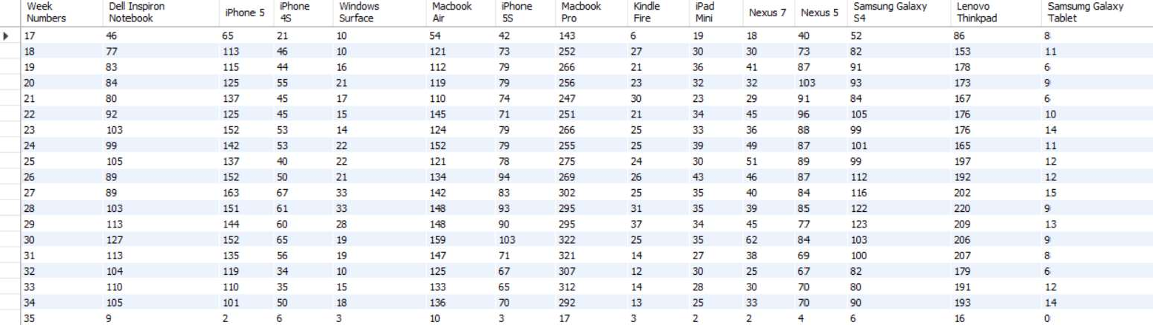

Slide 21
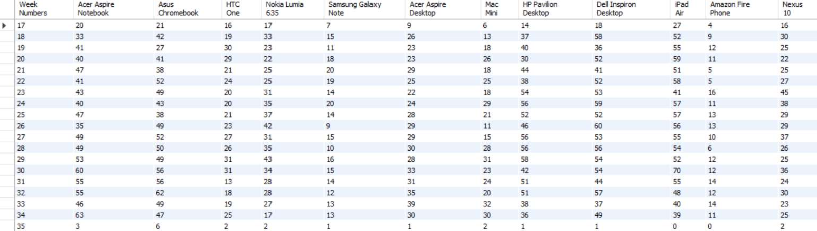

Slide 22
Email Enagagement
Select week,
round((weekly_digest/total*100),2) as "weekly digest rate", round((email_opens/total*100),2) as "email open rate", round((email_clickthroughs/total*100),2) as "email clickthrough rate", round((reengagement_emails/total*100),2) as "reengagement email rate" from
select extract(week from occurred_at) as week,
count(case when action = 'sent_weekly_digest' then user_id else null end) as weekly_digest,
count(case when action = 'email_open' then user_id else null end) as email_opens,
count(case when action = 'email_clickthrough' then user_id else null end) as email_clickthroughs,
count(case when action = 'sent_reengagement_email' then user_id else null end) as reengagement_emails,
count(user_id) as total from email_events group by 1) sub group by 1 order by 1;

Slide 23
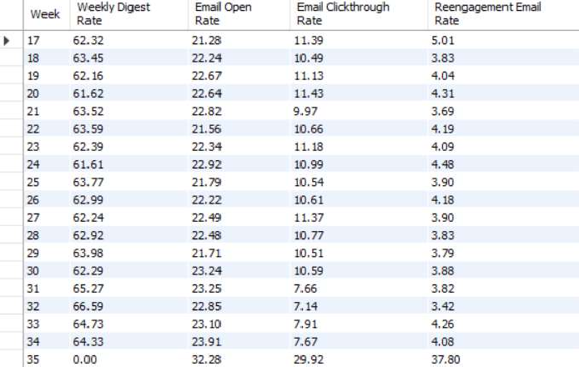

Slide 24
RESULT
This project has enabled me to comprehend the significance of operations in a company. By working on this project, I have gained valuable insights into how organizations use metric spikes to their advantage as a strategic tool. By adopting a proactive and informed approach, companies can leverage these insights to optimize their strategies and enhance their return on investment (ROI).

Slide 25
THANK YOU

